Slide 1
Artificial Intelligence CS-202
Topic: Machine Learning and Word Embeddings
Habiba Arshad
Department of Computer Science
University of Wah

Slide 2
Week-13 CLO’s
This week lecture will cover the following CLO’s:
CLO1: Discuss the key concepts in the field of artificial intelligence
CLO 2: Implement artificial intelligence techniques and case studies
CLO 3: Model an automated solution for given problems using artificial intelligence paradigm

Slide 3
CLO’s Mapping
CLO 1:
Introduction to NLP and Machine Learning
CLO 2:
Pre-processing and Feature Extraction
CLO 3:
Machine Learning Models Implementation

Slide 4
NLP And Machine Learning

Slide 5
What is Machine Learning:
“Machine learning is the field of study that enables a machine to automatically learn from data, improve performance from experiences, and predict things without being explicitly programmed.” (Arthur Samuel 1959)

Slide 6
What is Machine Learning
Machine learning (ML) is a branch of artificial intelligence (AI) focused on enabling computers and machines to imitate the way that humans learn, to perform tasks autonomously, and to improve their performance and accuracy through experience and exposure to more data.

Slide 7
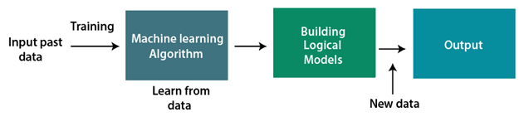
How does Machine Learning work
A Machine Learning system learns from historical data which in known as training data, builds the prediction models, and whenever it receives new data, predicts the output for it.
The accuracy of predicted output depends upon the amount of data, as the huge amount of data helps to build a better model which predicts the output more accurately.

Slide 8
Machine Learning Methods
Type | Description | Examples | Use Cases
1. Supervised Learning | Learn from labeled data to make predictions or classifications. | Linear Regression, Decision Trees, SVM | Spam detection, sentiment analysis, forecasting
2. Unsupervised Learning | Find patterns or groupings in unlabeled data. | K-Means, Hierarchical Clustering, PCA | Customer segmentation, topic modeling
3. Semi-Supervised Learning | Uses small labeled data + large unlabeled data for learning. | Modified supervised models | Medical imaging, speech recognition
4. Reinforcement Learning | Learn through trial and error to maximize rewards in an environment. | Q-Learning, Deep Q-Networks | Game AI, robotics, autonomous vehicles

Slide 9
Features of Machine Learning
Machine learning uses data to detect various patterns in a given dataset.
It can learn from past data and improve automatically.
It is a data-driven technology.
Machine learning is much similar to data mining as it also deals with the huge amount of the data.

Slide 10
Integrating NLP with Machine Learning
What is Integration?
Using machine learning models to analyse and process natural language data.
How It Works
Data Collection: Gathering raw text data.
Text Preprocessing: Tokenization, removing stop words, stemming, etc.
Feature Extraction: Converting text into numerical data (e.g., TF-IDF, Bag-of-Words, Word2Vec).
Model Application: Applying ML models like Logistic Regression, Decision Trees, or Neural Networks.
Evaluation: Assessing model performance (e.g., accuracy, F1-score).

Slide 11
Text Classification Techniques
Definition:
Assigning predefined labels to text (e.g., Spam vs. Non-Spam emails).
Techniques:
Supervised Learning:
Algorithms: Naive Bayes, SVM, Logistic Regression.
Example: Classify reviews as "Positive" or "Negative."
Unsupervised Learning:
Algorithms: K-Means, Hierarchical Clustering.
Example: Group documents into similar topics.
Real-World Example:
Spam Email Detection:
Input: Email text.
Output: "Spam" or "Not Spam."

Slide 12
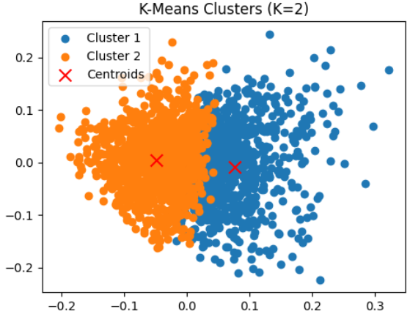
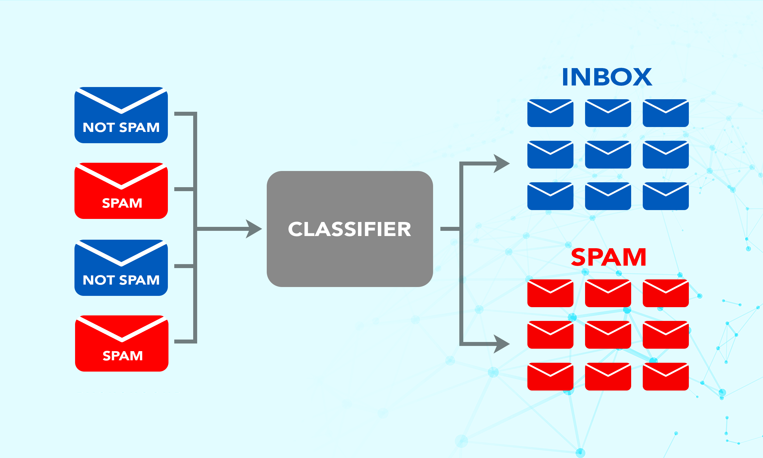
Text Classification

Slide 13
Word Embeddings

Slide 14
Word Embeddings
Word embedding in Natural Language Processing (NLP) is a technique used to represent words as numerical vectors in a continuous vector space.
These embeddings capture semantic meaning, syntactic properties, and relationships between words, allowing algorithms to process and analyze text more effectively.

Slide 15
Word Embeddings
For example, a computer can learn that “king” is more similar to “ruler” than “worker” by representing these words in a vector space where similar words are closer together.
These embeddings are learned using language modeling and feature learning techniques, allowing computers to understand and process the semantic relationships between words.

Slide 16
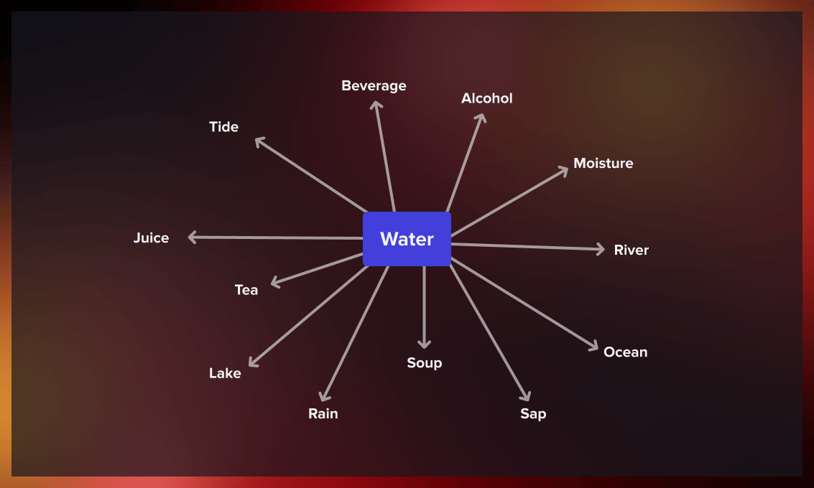
Word Embeddings
The meaning of a term is determined by its context: the words that come before and after it, which is called the context window.
Typically, this window is four words wide, with four words to the left and right of the target term.
To create vector representations of words, we look at how often they appear together.
Notes:
Word2Vec: Explanation and Examples

Slide 17
Techniques for Word Embeddings
TF-IDF: Numerical representation based on frequency and importance.
Word2Vec: Learns embeddings using neural networks
Typically uses 100 to 300 dimensions.
BERT: Transformer-based contextual embeddings (each word's meaning depends on context).
go much higher — up to 768 or even 1024 dimensions per token.

Slide 18
Sample Code Example
from gensim.models import Word2Vec
# Example corpus
sentences = [["I", "love", "machine", "learning"], ["NLP", "is", "fun"]]
# Train Word2Vec model
model = Word2Vec(sentences, vector_size=100, window=5, min_count=1, workers=4)
# Get the embedding vector for the word 'machine'
vector = model.wv['machine']
print(vector)
Values are floating-point numbers that encode the meaning of the word "machine" as learned by the model.
Each word will have a different vector, and similar words will have similar vectors in terms of cosine similarity.

Slide 19
Word Embedding using TF-IDF
Analyze the collection of four documents as follows and determine the tf-idf scores for each term in each document.
𝑑1​ : "The sky is blue.
𝑑2 : "The sun is bright today."
𝑑3: "The sun in the sky is bright."
𝑑4: "We can see the shining sun, the bright sun."

Slide 20
Word Embedding using TF-IDF
Step 1: Preprocess the documents
Convert to lowercase and tokenize each document.
Tokens:
d1: ["the", "sky", "is", "blue"]
d2: ["the", "sun", "is", "bright", "today"]
d3: ["the", "sun", "in", "the", "sky", "is", "bright"]
d4: ["we", "can", "see", "the", "shining", "sun", "the", "bright", "sun"]
Remove punctuation and stopwords if necessary.
[the, sky, is, blue, sun, bright, today, in, we, can, see, shining]

Slide 21
Word Embedding using TF-IDF
Step 2: Calculate Term Frequency (TF)
TF(t, d) = (Number of times term t appears in document d) / (Total number of terms in document d)
TF for each document:
d1:
"the": 1/4 = 0.25
"sky": 1/4 = 0.25
"is": 1/4 = 0.25
"blue": 1/4 = 0.25
d2:
"the": 1/5 = 0.2
"sun": 1/5 = 0.2
"is": 1/5 = 0.2
"bright": 1/5 = 0.2
"today": 1/5 = 0.2
d3:
"the": 2/7 ≈ 0.286
"sun": 1/7 ≈ 0.143
"in": 1/7 ≈ 0.143
"sky": 1/7 ≈ 0.143
"is": 1/7 ≈ 0.143
"bright": 1/7 ≈ 0.143
d4:
"we": 1/9 ≈ 0.111
"can": 1/9 ≈ 0.111
"see": 1/9 ≈ 0.111
"the": 2/9 ≈ 0.222
"shining": 1/9 ≈ 0.111
"sun": 2/9 ≈ 0.222
"bright": 1/9 ≈ 0.111

Slide 22
Word Embedding using TF-IDF
Step 3: Calculate Inverse Document Frequency (IDF)
IDF(t) = log_base 10(Total number of documents / Number of documents with term t)
Term | df | IDF
the | 4 | 0
sky | 2 | 0.301
is | 3 | 0.125
blue | 1 | 0.602
sun | 3 | 0.125
bright | 3 | 0.125
today | 1 | 0.602
in | 1 | 0.602
we | 1 | 0.602
can | 1 | 0.602
see | 1 | 0.602
shining | 1 | 0.602
𝑑1​ : "The sky is blue.
𝑑2 : "The sun is bright today."
𝑑3: "The sun in the sky is bright."
𝑑4: "We can see the shining sun, the bright sun."

Slide 23
Word Embedding using TF-IDF
Step 4: Calculate TF-IDF
TF-IDF(t, d) = TF(t, d) * IDF(t)
TF-IDF Scores:
d1:
d2:
Term | TF | IDF | TF-IDF
the | 0.33 | 0 | 0
sun | 0.17 | 0.125 | 0.021
in | 0.17 | 0.602 | 0.100
sky | 0.17 | 0.301 | 0.050
is | 0.17 | 0.125 | 0.021
bright | 0.17 | 0.125 | 0.021
d3:
d4:
Term | TF | IDF | TF-IDF
the | 0.25 | 0 | 0
sky | 0.25 | 0.301 | 0.075
is | 0.25 | 0.125 | 0.031
blue | 0.25 | 0.602 | 0.151
Term | TF | IDF | TF-IDF
we | 0.125 | 0.602 | 0.075
can | 0.125 | 0.602 | 0.075
see | 0.125 | 0.602 | 0.075
shining | 0.125 | 0.602 | 0.075
sun | 0.25 | 0.125 | 0.031
the | 0.125 | 0 | 0
bright | 0.125 | 0.125 | 0.016
Term | TF | IDF | TF-IDF
the | 0.20 | 0 | 0
sun | 0.20 | 0.125 | 0.025
is | 0.20 | 0.125 | 0.025
bright | 0.20 | 0.125 | 0.025
today | 0.20 | 0.602 | 0.120

Slide 24
Word Embedding using TF-IDF
Final TF-IDF Scores:
d1{ 0, 0.075,0.031,0.151}
d2{0, 0.025, 0.025, 0.120}
d3{0, 0.021,0.100,0.050, 0.021, 0.021}
D4{ 0.075, 0.075, 0.075, 0.075, 0.031, 0, 0.016}

Slide 25
Word Embedding using TF-IDF
Purpose of TF-IDF: TF-IDF is used to find how important a word is in a document compared to other documents.
Result of calculation: Common words like “the” get very low or zero scores, while unique words like “blue”, “today”, and “shining” get higher scores.
Conclusion: The final TF-IDF vectors represent each document using important words, which helps in document comparison and search.

Slide 26
Word2Vec
Word2Vec (word to vector) is a technique used to convert words to vectors, thereby capturing their meaning, semantic similarity, and relationship with surrounding text.
This method helps computers learn the context and association/ meaning of expressions and keywords from large text collections such as news articles and books.

Slide 27
Word2Vec
How It Works
Continuous Bag of Words (CBOW):
Predicts a word based on its surrounding context.
Skip-Gram:
Predicts surrounding words given a single word.

Slide 28
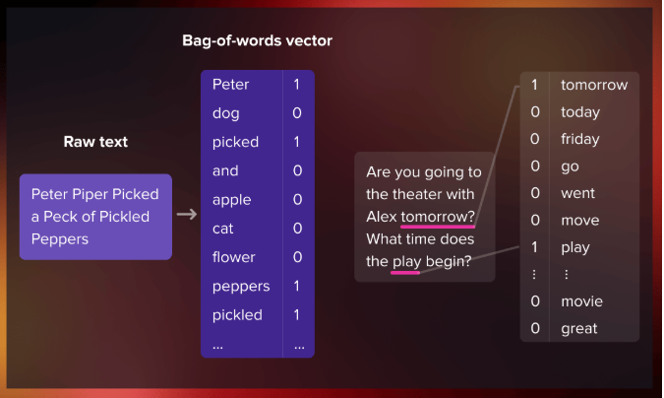
Continuous bag-of-words (CBOW)
The continuous bag-of-words model predicts the central word using the surrounding context words, which comprises a few words before and after the current word.

Slide 29
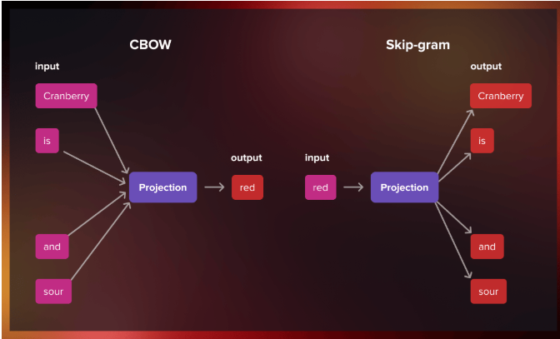
Skip-gram
The skip-gram model architecture is designed to achieve the opposite of the CBOW model.
Instead of predicting the center word from the surrounding context words, it aims to predict the surrounding context words given the center word.
Notes:
The choice between the two approaches depends on the specific task at hand. The skip-gram model performs well with limited amounts of data and is particularly effective at representing infrequent words. In contrast, the CBOW model produces better representations for more commonly occurring words.

Slide 30
Explanation Continue
Example:
Input Sentence: "I love NLP."
Output:
"I" → [0.1, 0.3, 0.5]
"love" → [0.2, 0.4, 0.6]
"NLP" → [0.3, 0.5, 0.7].

Slide 31
Text Classification with Word Embeddings
Problem:
Classify movie reviews as "Positive" or "Negative."
Steps:
Input: Reviews like "The movie was great."
Preprocessing: Remove stop words, tokenize, and convert to embeddings.
Feature Representation:
Word2Vec generates numerical vectors for words.
Model Application:
Train an ML classifier (e.g., Logistic Regression) using embeddings.
Output: Sentiment = Positive.
Visualization:
Show embeddings in a vector space.

Slide 32
Applications of NLP with Machine Learning
Applications
Chatbots and Virtual Assistants
Understand user queries and generate responses.
Spam Filtering
Classify emails as spam or not.
Sentiment Analysis
Gauge opinions from reviews.
Search Engines
Cluster and rank results based on relevance.
Key Takeaway
Combining NLP and ML makes language processing scalable and intelligent.

Slide 33
Working Example: End-to-End Text Processing with Word2Vec
Step 1: Input and Preprocessing
Input Sentence: "NLP is fun"
Preprocessing Steps:
Convert to Lowercase: Input → "nlp is fun"
Tokenization: Split the sentence into words: Tokens → ["nlp", "is", "fun"]
Remove Stop Words (if required): Common stop words like "is" can be removed. Result → ["nlp", "fun"]
Step 2: Generating Word Embeddings with Word2Vec
Word2Vec maps each word to a dense numerical vector based on its context in the corpus.
Assume a pre-trained Word2Vec model generates the following embeddings for each word
Word | Embedding Vector (3D for simplicity)
NLP | [0.5, 0.1, 0.8]
is | [0.2, 0.6, 0.4]
fun | [0.9, 0.7, 0.3]

Slide 34
Vector Representation for the Sentence:
Sentence Embedding → Combine word embeddings (e.g., by averaging):
Sentence Vector = (NLP+is+fun)/3
Sentence Vector = ([0.5,0.1,0.8]+[0.2,0.6,0.4]+[0.9,0.7,0.3])/3
Sentence Vector = [0.53,0.47,0.5]
Step 4: Using a Model
Example Task: Text Classification
Let’s assume the task is to classify the sentence as Positive or Negative.
Input to Model: Use the sentence embedding [0.53, 0.47, 0.5] as input to a classification model (e.g., Logistic Regression or Neural Network).
Model Training:
Training Data: Use labelled embeddings of sentences (e.g., embeddings of "I love NLP" → Positive, and "I hate this task" → Negative).
Train: The model learns patterns in the embedding space that associate vectors with labels.
Output: Positive
Step 3: Feature Extraction
The sentence embedding [0.53, 0.47, 0.5] is the extracted feature representation for the entire sentence. These features can now be passed into a machine learning model for various tasks, such as classification or clustering.

